Slide 1

UC2: Inspector-Triggered
Ticket Purchase Fraud
Detecting Fare Evasion on MBTA Commuter Rail
WPI Capstone | Masabi × Gemsen | Team 2
Team 2:
Daniel Duah,
Bismark Kofi Sarfo,
Sai Priya Malyala,
Martin Thulani Milanzi,
Sai krishna Vaddeboina
April 2026

Slide 2
Agenda
01
The Problem
What is inspector-triggered fare evasion and why Pattern's rules fall short
02
What We Did
Our pipeline: feature engineering, 9-state HMM, 4-signal anomaly scoring, clustering
03
What We Found
15,195 novel riders, 3 evasion archetypes, 6 distinct clusters
04
Implications
What this means for Masabi, Pattern, and fare revenue recovery

Slide 3
01
The Problem
What is inspector-triggered fare evasion
and why can't Pattern detect it?

Slide 4
How Fare Evasion Works on Commuter Rail
👀
🎫
📱
✅
Rider spots
inspector
→
Buys or
activates ticket
→
Inspector
scans ticket
→
Appears
legitimate
Sees inspector
boarding the train
Purchases instantly
or activates held ticket
Gap: 0.002 to
30 seconds
Looks like a valid
paying rider
The result: riders travel without paying, costing transit agencies millions in lost fare revenue

Slide 5
Pattern's Two Detection Rules
Pattern uses two count-based rules to flag suspicious riders:
RULE A — HIGH SEVERITY
54,226 riders flagged (24.5%)
≥3 activation-to-scan gaps ≤15 seconds within any rolling 10-day (240-hour) window
A rider must have at least 3 events where they activated their ticket and were scanned by an inspector within 15 seconds, all occurring within a 10-day period.
RULE B — MEDIUM SEVERITY
55,853 riders flagged (25.2%)
≥3 activation-to-scan gaps ≤30 seconds within any rolling 7-day (168-hour) window
A wider time gap (30 seconds) but a shorter rolling window (7 days). Catches riders who are slightly slower but still suspiciously fast.
Combined: 58,752 riders (26.5%) trigger at least one rule | Rule windows are non-interchangeable

Slide 6
Why Pattern's Current Rules Fall Short
Pattern flags riders with ≥3 fast activation events in a rolling window. This catches many evaders — but it has three structural blind spots:
🛒
🧠
📊
No Purchase
Timing
No Sequence
Memory
Fixed Count
Thresholds
Pattern only measures activation-to-scan gap. It cannot detect riders who buy a ticket the moment they see an inspector — the strongest evasion signal.
Every event is scored in isolation. Pattern has no memory of what a rider did yesterday, last week, or across their history. It cannot detect persistent behavioural patterns.
Riders need ≥3 fast events in a window to be flagged. Sophisticated evaders stay at 1-2 fast events per window, making them invisible forever.
Our goal: build a pipeline that fills these gaps without replacing Pattern

Slide 7
Four research questions that aligns with study purpose
Where do Pattern's existing rules leave blind spots?
RQ1
Quantifies the population that escapes Rule A (≤15 s) and Rule B (≤30 s) thresholds.
Can sequence modelling identify evasion archetypes that fixed rules cannot?
RQ2
Tests whether HMM latent states correspond to interpretable behavioural strategies.
Do anomaly-selected riders separate into operationally distinct groups?
RQ3
Uses unsupervised clustering on rider-level features to find actionable archetypes.
What is the smallest reviewable evidence set Masabi can act on?
RQ4
Determines the throughput of the human-in-the-loop labelling step for Exercise 4.
UC2 - Team 2
3 / 17

Slide 8
02
What We Did
Feature engineering, HMM training,
multi-signal anomaly scoring, and clustering

Slide 9
Our Pipeline — End to End
1
2
3
4
5
Data Ingestion
Feature Engineering
9-State HMM
Anomaly Scoring
Clustering
2.9M events from AWS S3
221,382 riders
13 commuter rail lines
→
86 features in 14 groups
Timing, gaming, inspector,
GPS, weather, calendar
→
65,376 training riders
50/50 stratified sample
3 evasion archetypes found
→
4 weighted signals
221,382 riders scored
Continuous 0-1 scale
→
61,869 selected riders
K=6 (silhouette-optimised)
6 distinct profiles
All 4 sponsor recommendations implemented: parallel training, FIFO cap 30, MIN_EVENTS=5, posterior dominance
Platform: SymetryML | Storage: AWS S3 | Training: 11.4 hours (8 cores, joblib loky) | 70 HMM fits across 7 state counts

Slide 10
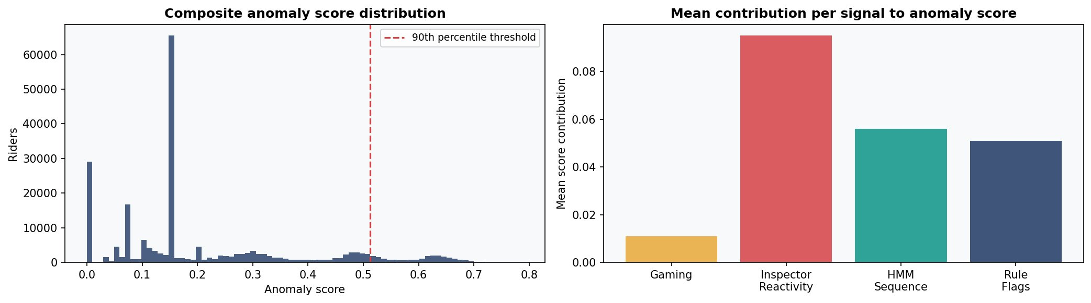
How We Score Every Rider
30%
25%
25%
20%
Inspector
Reactivity
HMM
Sequence
Gaming
Suspicion
Rule
Flags
Does the rider activate
faster when an inspector
is on the commuter train?
What fraction of the
rider's behavioural sequence
is in evasion states?
Do activations cluster
in the 16-30 second range
upon seeing an inspector?
Has Pattern already
flagged this rider under
HIGH or MEDIUM rules?

Slide 11
The HMM Discovered 3 Evasion Archetypes
State 1
State 0
State 3
Habitual Evader
Purchase-Triggered
Moderate Evader
20,075 riders
11,920 riders
20,099 riders
ACTIVATE_FAST_HANDHELD (75.3%)
PURCHASE_THEN_ACTIVATE_FAST (36.7%)
ACTIVATE_FAST_HANDHELD (46.3%)
Self-transition: 0.984
Self-transition: 0.971
Self-transition: 0.973
Activates fast virtually every time.
Once in this state, only 1.6% chance
of leaving on any given event.
Buys ticket only when they see
an inspector. Pattern has no
purchase-timing logic at all.
Alternates fast and slow activations.
Stays below Pattern's ≥3 threshold
by mixing behaviour.
Self-transitions > 0.97 mean evasion is habitual, not situational — riders who evade once will almost certainly evade again

Slide 12
03
What We Found
15,195 riders Pattern misses, 6 clusters,
and a 20.5% novelty rate

Slide 13
15,195
riders that Pattern's rules completely miss
Zero
triggered Rule A or Rule B — verified, not estimated
0.784
mean suspicious_state_pct — 78% of sequence in evasion states
3.4
mean fast-15s events — just below Pattern's ≥3 threshold
20.5%
novelty rate — exceeds the 20% sponsor benchmark

Slide 14
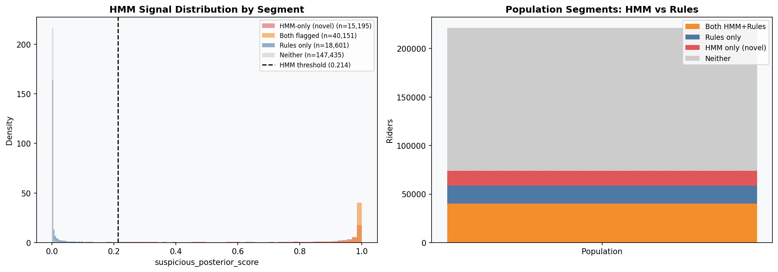
HMM Novelty — Where Pattern Falls Short
40,151
18,601
15,195
147,435
Both HMM + Rules (18.1%)
Rules only (8.4%)
HMM only (novel) (6.9%)
Neither (66.6%)
69.6% of novel riders come from Cluster 1 — predominantly State 3 (Moderate, 52.9%) and State 0 (Purchase-Triggered, 28.2%)

Slide 15
6 Evasion Clusters — Who Are These Riders?
C0
7,136
C1
12,606
C2
10,122
Rule-Flagged
Evader
HMM-Novel
Anomaly
Confirmed
Evader
Score: 0.416 | Rule A: 58.9%
Score: 0.331 | Rule A: 3.1%
Score: 0.585 | Rule A: 100%
Peak-hour evasion
83.9% are novel
58 fast events avg
C3
22,199
C4
8,644
C5
1,162
Large Evader
Pool
HMM-
Discordant
Inspector-
Reactive
Score: 0.534 | Rule A: 97.6%
Score: 0.399 | Rule A: 92.2%
Score: 0.365 | Rule A: 0.1%
Largest cluster
Possible false pos.
Gaming 1.639

Slide 16
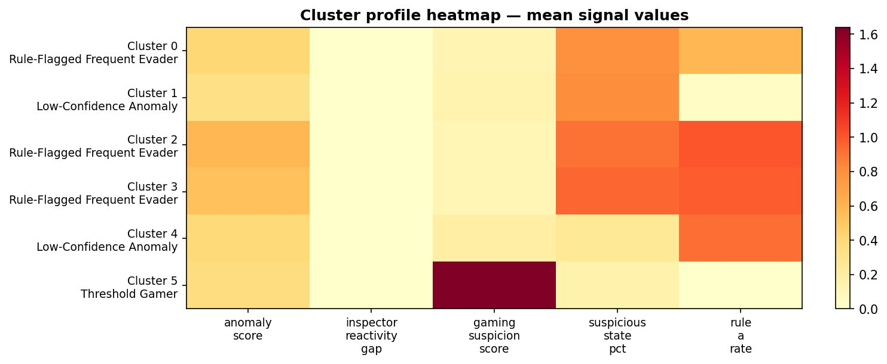
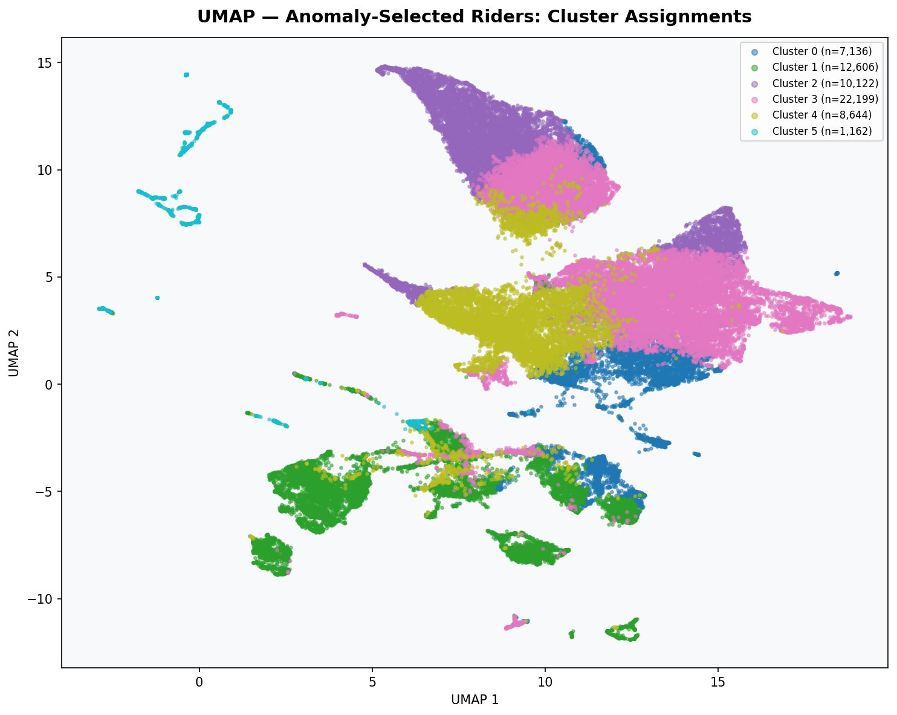
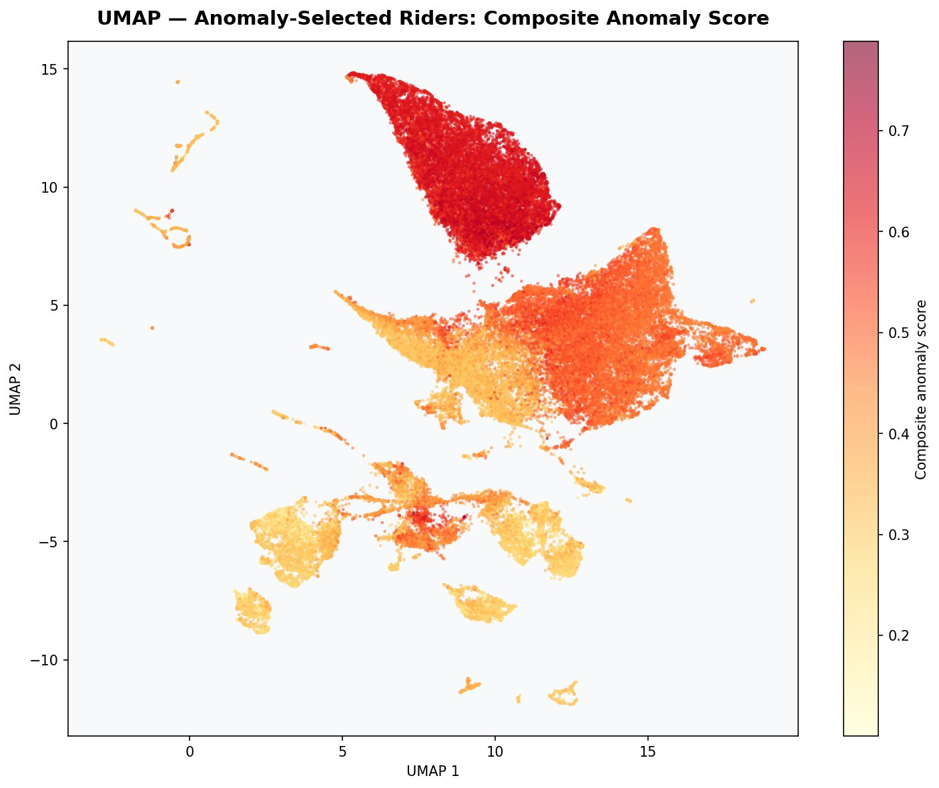
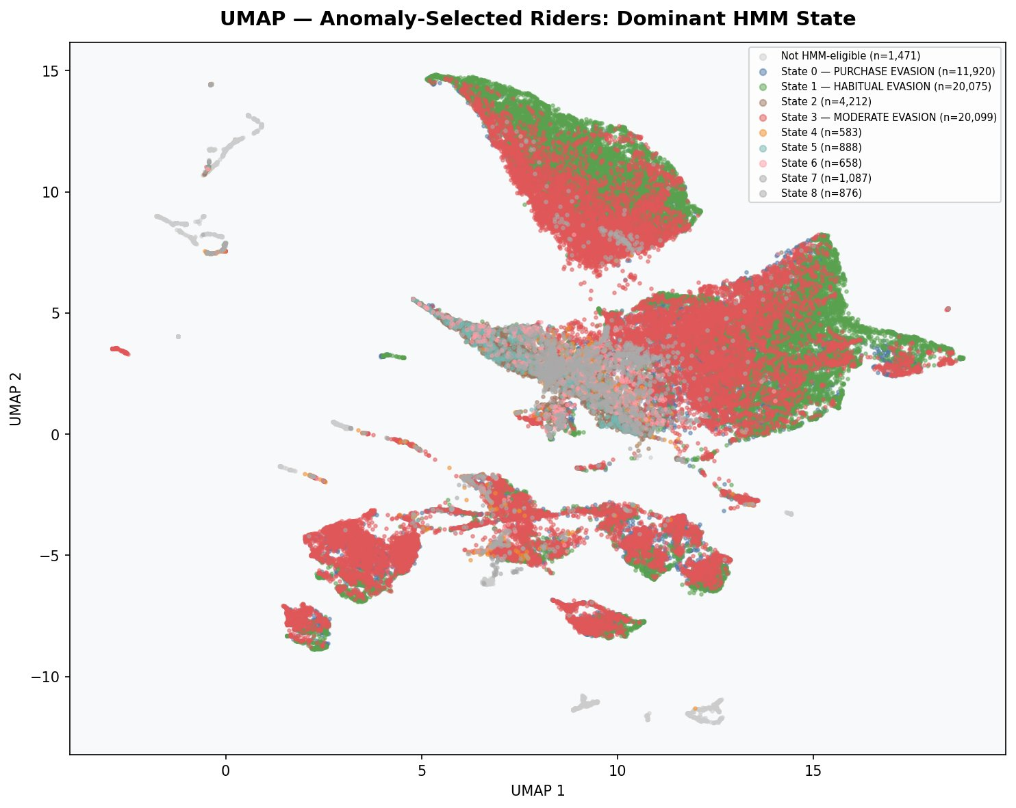
Cluster Profiles & UMAP Visualisation

Slide 17
04
Implications
What this means for Masabi, Pattern,
and fare revenue recovery

Slide 18
Implications for Masabi/Gemsen on the Pattern
15,195 riders = lost revenue
Pattern can be extended, not replaced
These riders travel without paying and have never been detected. Each rider represents lost fare revenue on every trip. Across thousands of trips over months, this is a significant revenue gap.
The pipeline doesn't make Pattern obsolete — it adds three capabilities Pattern lacks. Pattern's rules remain 20% of the composite score and provide strong baseline confirmation.
Cluster-specific enforcement
False positive reduction
Different clusters need different responses. Cluster 2 needs immediate enforcement. Cluster 1 needs Masabi validation. Cluster 5 reveals a new evasion behaviour Pattern should monitor.
Cluster 4 (8,644 riders) may be false positives — 92% rule-flagged but HMM sees as non-suspicious. Pattern may be over-flagging this population, wasting inspector resources on legitimate riders.

Slide 19
Recommended Actions by Cluster
C2
10,122
IMMEDIATE ACTION
Highest-risk. Deploy targeted inspection on high-density routes.
C3
22,199
PRIORITISE REVIEW
Validate via Masabi review sheet, then apply to full group.
C0
7,136
PEAK ENFORCEMENT
Focus inspectors on peak-hour commuter trains.
C1
12,606
MASABI REVIEW
83.9% novel. Must validate if genuine evaders or false positives.
C4
8,644
INVESTIGATE FPs
Rule-flagged but HMM non-suspicious. May be over-flagging.
C5
1,162
MONITOR
Inspector-reactive activators. Invisible to Pattern.

Slide 20
Thank You
Team 2 | WPI Capstone
Masabi × Gemsen | SymetryML Platform | April 2026
Questions?

